Slide 1

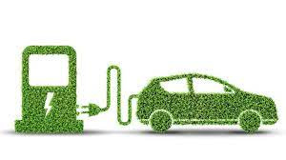

ELECTRICAL VEHICLE REVOLUTION INSIGHTS
By Megha Bhande(Bagal)

Slide 2
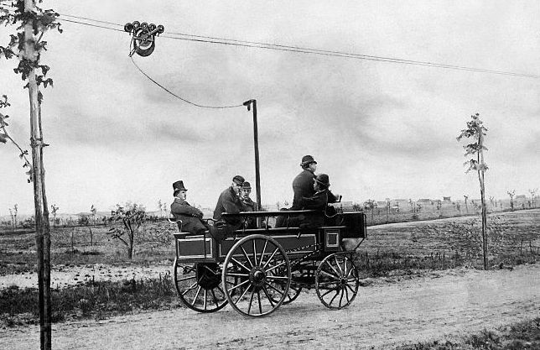
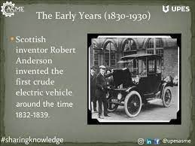
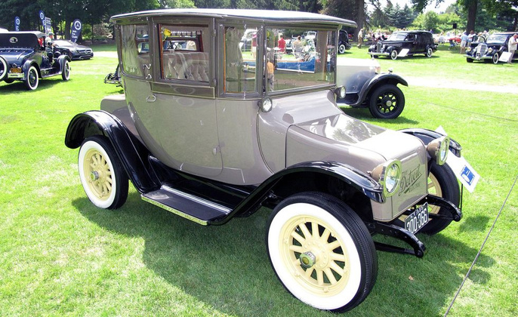

What is Electric Vehicles ?
Electric vehicles (EVs) are automobiles powered by electric motors, utilizing rechargeable batteries or fuel cells as their primary source of energy.
First Electric Vehicles
The United States was developed in the 1830s by Robert Anderson, a Scottish inventor.
Electric Vehicles Brand
Baker Electric (1899 to 1915) a range of around 80 km (50 miles)
Global Initiatives for EV Adoption
Current zero emission policies, Future roadmap for adopting EV cars
Distance range EV Vehicles
Average driving range is 250 – 500 miles single charge.(depending on the make and model)

Slide 3

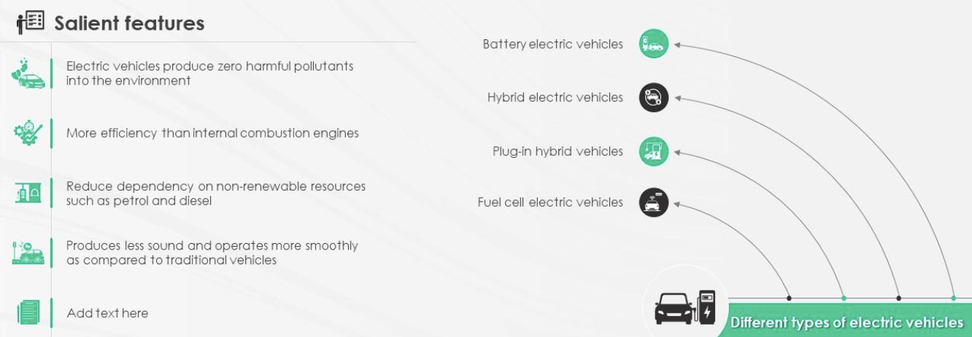
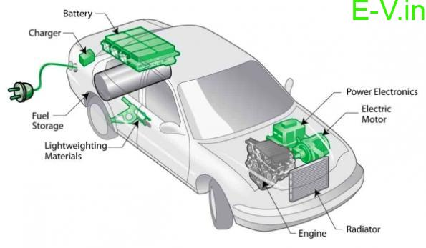

TYPES AND FEATURES

Slide 4
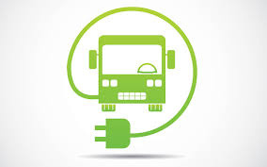
EV Overview
SITUATION
The electric vehicle (EV) is undergoing a rapid transformation, with technological advancements, supportive policies, and changing consumer behavior driving the widespread adoption of EVs.
TASK
Analyzing an electric car dataset to understand market dynamics, including location, make, model distribution, incentives, utility providers, and price ranges.
ACTION
Collecting a information on EV sales, market share. Creating relationships between different data sources, Visualization. the role of battery technology, the adoption rates in different regions, and the potential for future growth.
RESULT
More electric Vehicles used globally cut pollution. Better EVs tech means they drive farther and use less energy. More places to charge EVs make it easier. Using EVs saves money over time because they cost less to run.

Slide 5
DASHBOARD By Country
SITUATION
The auto industry is shifting as Electric Vehicles (EVs) gain traction globally, prompting a need to track sales trends for stakeholders, policymakers, and investors.
TASK
The dashboard will encompass key metrics such as EV sales by country and year, total EV count, new model introductions, and a visual representation through an EV country map.
ACTION
Analyze EV sales trends by country over time with interactive filters; Present global EV count trends and model-specific sales breakdowns, enhancing decision-making for stakeholders.
RESULT
This dashboard helps people understand the EV market better. It lets them see what's changing, so they can make smart choices about electric vehicles.

Slide 6
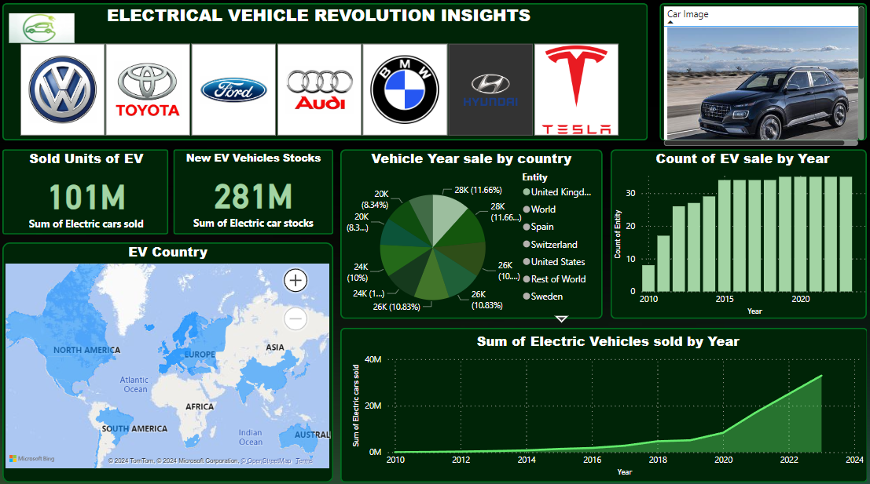
DASHBOARD By Country

Slide 7
DASHBOARD by Washington (US)
SITUATION
With EVs becoming more popular, Using Washington's EV data, we can create a dashboard that shows how EVs are being used, making it easier for people to make smart decisions.
TASK
The goal is to design a dashboard that effectively communicates the key statistics and trends in the electrical vehicle market in Washington state.
ACTION
Total vehicles and average electric vehicle range in Washington; Categorize EVs by type and CAFV eligibility, breakdown by model year, state, make, city, and model, highlighting popular models and market shares.
RESULT
Dashboard helps interested parties understand Washington's EV data, find trends, and plan for sustainable transport.

Slide 8
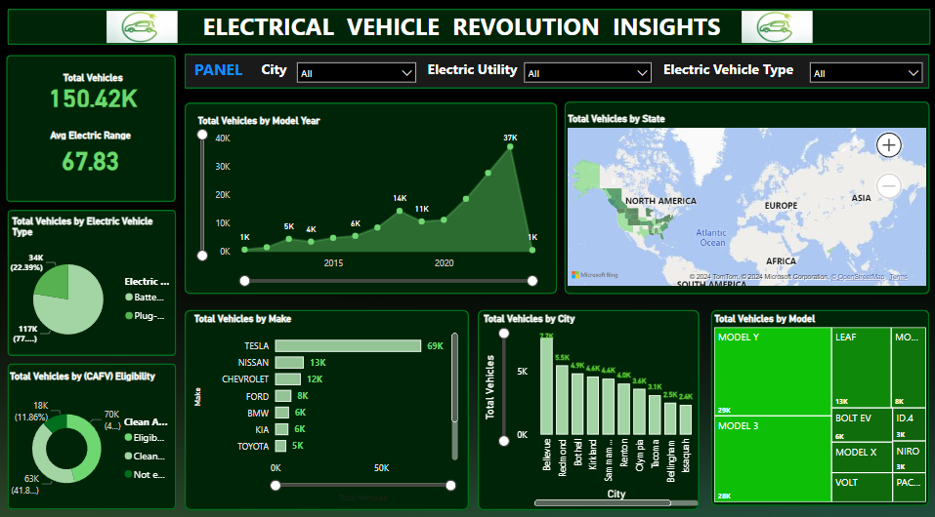
DASHBOARD by Washington (US)

Slide 9
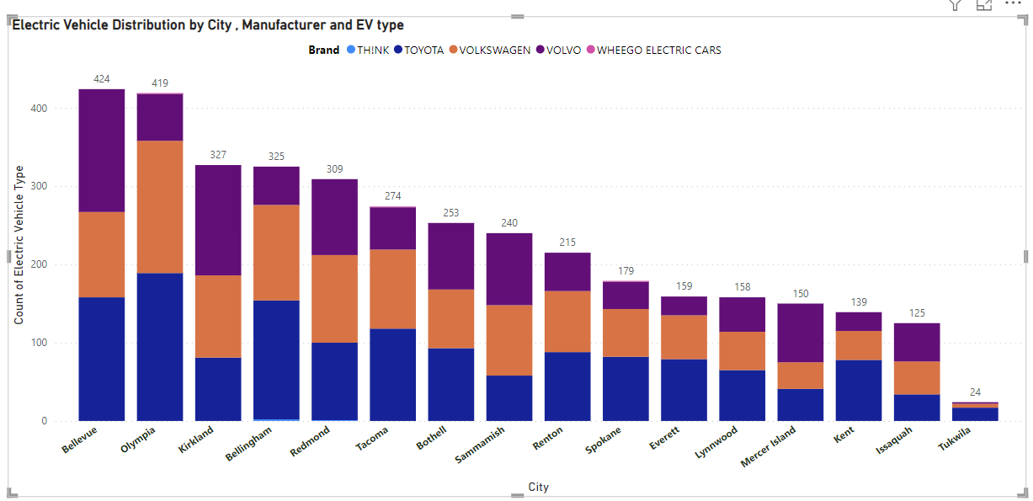
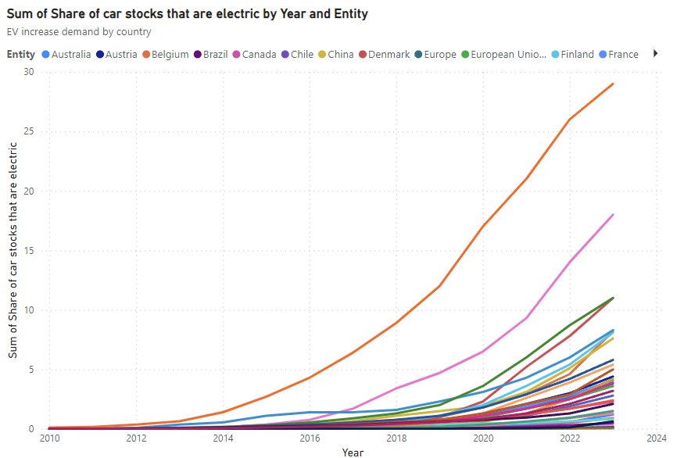
Visualization of EV Distribution
SITUATION
Analyzing EV distribution by city, manufacturer, and type is vital for understanding market trends.
TASK
This data aids stakeholders in understanding the EV market.
ACTION
the total number of electric vehicles in different cities, by leading manufacturers, and categorized by EV types, offering insights into EV adoption, market share, and technology preferences.
RESULT
This data helps find cities with lots of EVs, top manufacturers, and EV types, guiding smart choices and EV progress.
Visualization of EV stocks
SITUATION
Analyzing the sum of electric vehicle stocks by year and entity is vital for strategic industry planning and decision-making.
TASK
The evolution of electric vehicle adoption across different entities over the years.
ACTION
Showing electric vehicle adoption trends by entity over time, enabling stakeholders to identify key patterns and make informed decisions.
RESULT
Identify the years with the highest sum of electric vehicle stocks that are electric, which can inform investment decisions and strategic planning.

Slide 10
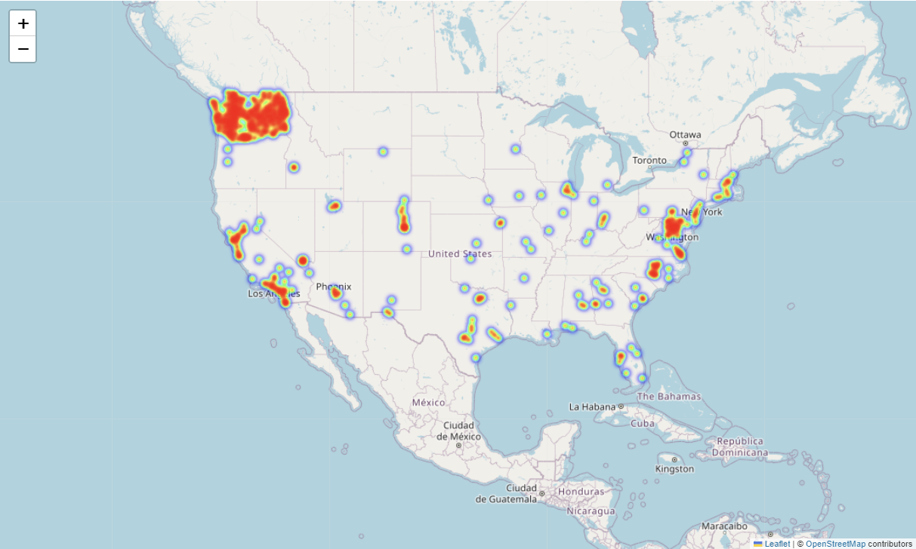
Visualization of Electric Vehicles Washington state location
SITUATION
The distribution and location of electric vehicles is crucial for optimizing infrastructure planning and promoting further adoption.
TASK
To visualize the location of electric vehicles in Washington state.
ACTION
Create an interactive HeatMap with color-coded density indicators for easy analysis.
RESULT
HeatMap offers insights on EV distribution for informed infrastructure planning and promotion strategies.

Slide 11
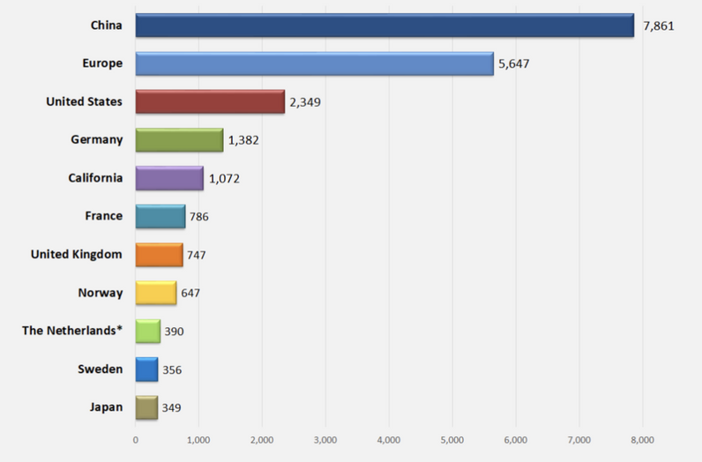
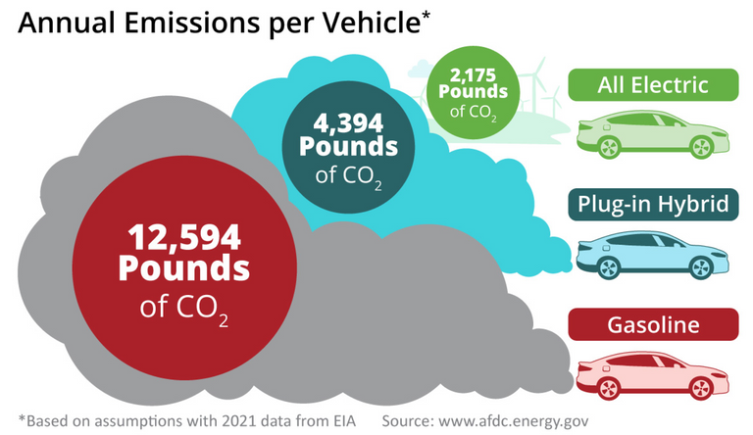
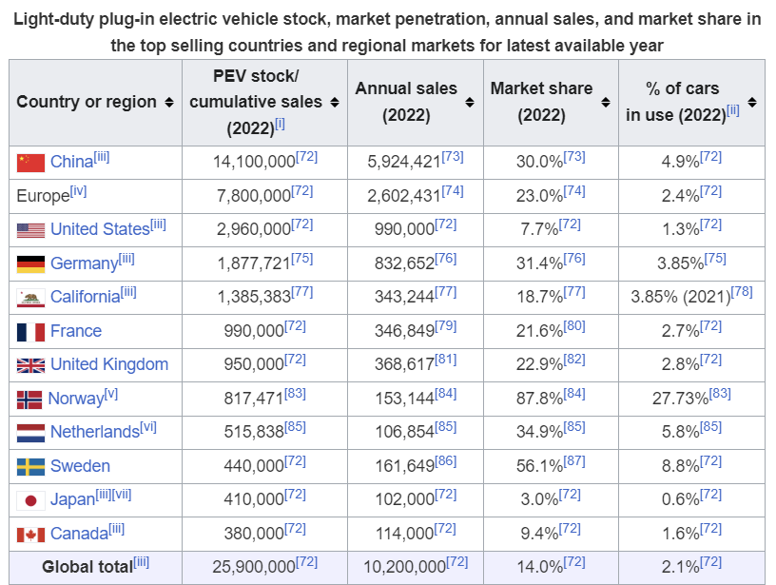
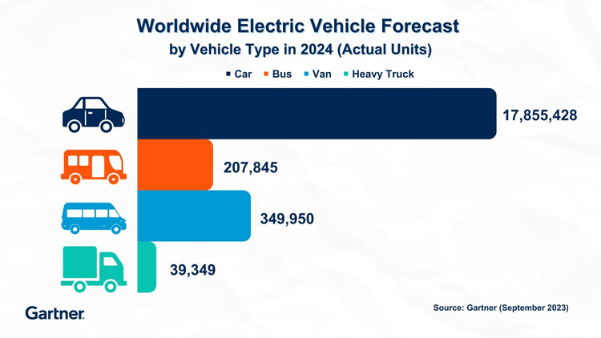
Fuel consumption
Using electric vehicle battery how much fuel consumption saving by approximately 60% to 70% .
China (2023)
saving
Fuel consumption
A study by the US Department of Energy has found the nation's fleet of electric cars 'saved' the equivalent of 1.8 billion litres of fuel last year – an estimated 1.2 days supply for 276 million registered vehicles.

Slide 12
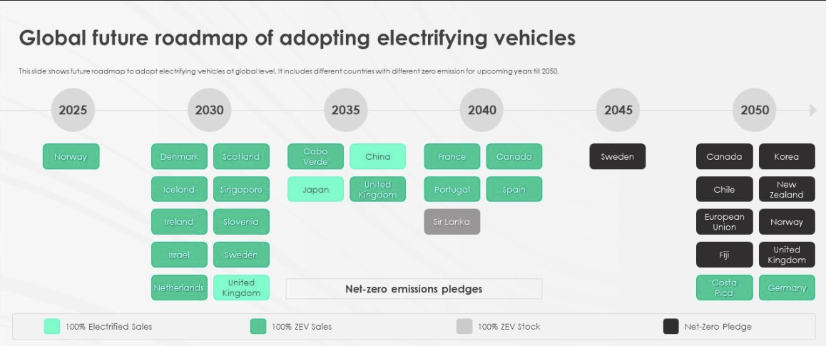
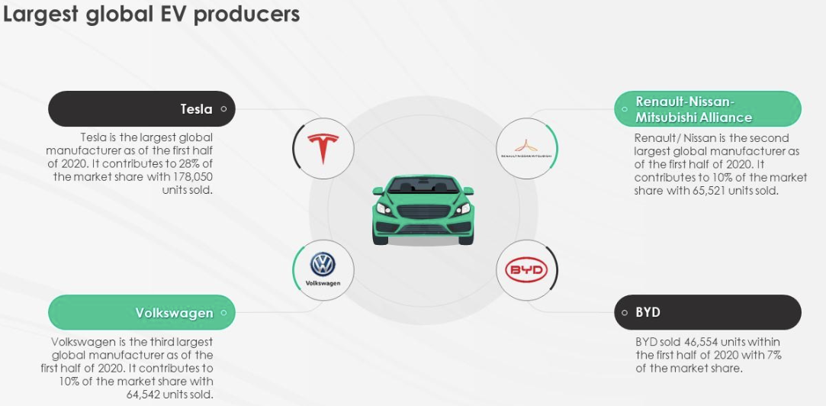
Q&A
Which country has largest EV cars?
China - 3 million electric car sales.
Which country has 100% EV cars?
Norway were all-electric vehicles.
Which manufacturer has highest selling EV
model?
Tesla Model Y is the largest EV manufacturer in the world.
Who leads the world in EV?
Iceland, Sweden, the Netherlands, and China are the leading EV adopters after Norway.
How many EV cars are on the road in the world?
More than 40 million.

Slide 13
Conclusion
The world is moving towards sustainable transport. With the rise in environmental awareness advanced battery technology and the support of government policies. The adoption of electric vehicles continues to grow. The auto industry will determine how transportation will be in the near future. It also helps to create the environment by being cleaner and greener.

Slide 14

Thank You

